Slide 1


Lecture 21 Web Application State Management
CSE 445 / 598
Distributed Software Development
View State
Cross Page Posting
Cookies
Session State and Application State
Server-Side File System
Caching
Database (in CSE446/598)

Slide 2
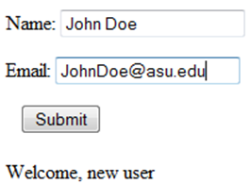
Reviewing Cookies from Last Lecture
Create a new cookie object using a key
protected void Button1_Click(object sender, EventArgs e)
{
HttpCookie myCookies = new HttpCookie("myCookieId");
myCookies["Name"] = TextBox1.Text;
myCookies["Email"] = TextBox2.Text;
myCookies.Expires = DateTime.Now.AddMonths(6);
Response.Cookies.Add(myCookies);
lblUser.Text = "Name stored in Cookie " + myCookies["Name"];
lblEmail.Text = "Email stored in Cookie " + myCookies["Email"]; }
}
Add my content to the cookie collection
Read cookie content and display at the given label

Slide 3
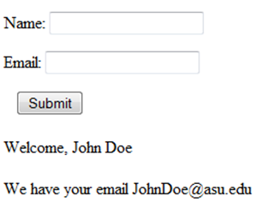
Reviewing Cookies from Last Lecture
Access a Cookie object using the same key
using System.Net; // needed for Cookies
public partial class _Default : System.Web.UI.Page {
protected void Page_Load(object sender, EventArgs e) {
HttpCookie myCookies = Request.Cookies["myCookieId"];
if ((myCookies == null) || (myCookies["Name"]=="")) {
lblUser.Text = "Welcome, new user";
} else {
lblUser.Text = "Welcome, " + myCookies["Name"];
lblEmail.Text = "We have your email " + myCookies["Email"];
}
}
// continued on next page
Check if the Cookie exist or is empty
Read data stored in Cookie and display

Slide 4
Session State
View State and Cookie can store string data on client side:
View State: in hidden fields in html page in web browser
Cookie: in client machine’s hard drive
Session state allows you to store structured objects in the server;
The scope of session state is within all pages of the session, but not cross different sessions;
The syntax is similar to ViewState and Cookies
The information in Session state is secure
The information is linked to the session. Other sessions of the same application cannot access the information;
A unique 120-bit hash number is generated to associate the user to the session: The number is sent to user as an id, and the user session must carry the id in order to revisit the session. Try the service that can generate the ID: http://venus.eas.asu.edu/WSRepository/Services/HashSha512/Service.svc

Slide 5
Understanding Session and State
Shopping cart 1
Browser
Session 1
Issue a unique Hash ID number x
Session
x
x
Browser
Issue a unique Hash ID number y
Session 2
ASPX Application
y
Session
y
cart 2
z
z
Browser
Session
Session 3
Issue a unique Hash ID number z
cart 3

Slide 6
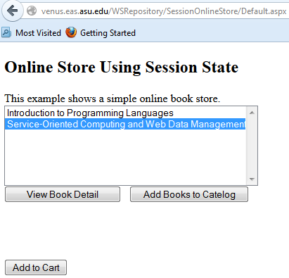

Use Session State To Store Objects
http://venus.eas.asu.edu/WSRepository/SessionOnlineStore/Default.aspx

Slide 7
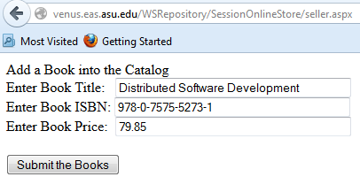
Seller Page for Entering Information
Seller.aspx

Slide 8
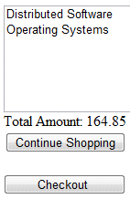
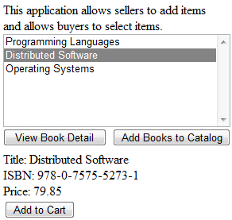
Returns to Default Page

Slide 9
Default.aspx.cs -- Book Class Definition
public class Book
{ public string _Title;
public string _Isbn;
public double _Price;
public bool _InCart; // whether the book is in cart
public Book(string title, string isbn, double price)
{ _Title = title;
_Isbn = isbn;
_Price = price;
_InCart = false;
}
}
The constructor loads the parameter values into the class variables

Slide 10
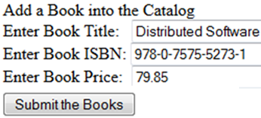
Seller.aspx.cs
public partial class Seller : System.Web.UI.Page {
protected void Page_Load(object sender, EventArgs e) { }
protected void btnSubmitBook_Click(object sender, EventArgs e) {
string title = txtTitle.Text;
string isbn = txtIsbn.Text;
string sPrice = txtPrice.Text;
double price = Convert.ToDouble(sPrice);
Book aBook1 = new Book(title, isbn, price);
string num = Convert.ToString(Session.Count + 1); // Find the next free spot
string catalogKey = "sBook" + num; // Form the index key for next session spot
Session[catalogKey] = aBook1; // Add an object into session state
Response.Redirect("Default.aspx"); // Return to catalog page
}
protected void txtIsbn_TextChanged(object sender, EventArgs e){
// text change handler
}
}
Allow you to write an event handler to response to the change of the text. For example, auto update when a number changes

Slide 11
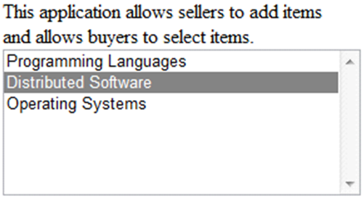
Default.aspx.cs
public partial class _Default : System.Web.UI.Page
{
Book aBook1, aBook2, aBook3;
string indexKey;
protected void Page_Load(object sender, EventArgs e) {
if ((Session.Count != 0) && (ListBox1.Items.Count == 0)) {
aBook1 = (Book)Session["sBook1"];
ListBox1.Items.Add(aBook1._Title);
aBook2 = (Book)Session["sBook2"];
ListBox1.Items.Add(aBook2._Title);
aBook3 = (Book)Session["sBook3"];
ListBox1.Items.Add(aBook3._Title);
}
}
// Continued next page
Code to be executed every time the page is loaded/reloaded.
There is information available in session state
The ListBox is empty

Slide 12
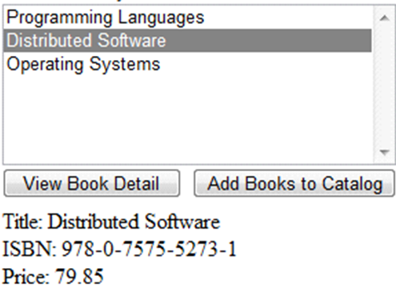
Default.aspx.cs (Contd.)
protected void btnSeller_Click(object sender, EventArgs e)
{
Response.Redirect("Seller.aspx");
}
Jump to from Default page to Seller page
protected void btnViewBook_Click(object sender, EventArgs e) {
if (ListBoxCatalog.SelectedIndex < 0 )
lblTitle.Text = "Please select a book in the list above";
else {
string num = Convert.ToString(ListBoxCatalog.SelectedIndex + 1);
indexKey = "sBook" + num; // Find the selected book
Book aBook = (Book)Session[indexKey];
lblTitle.Text = "<br />Title: " + aBook._Title;
lblIsbn.Text = "<br />ISBN: " + aBook._Isbn;
lblPrice.Text = "<br />Price: " + aBook._Price;
}
}
No item selected

Slide 13
Default.aspx.cs: Add to Cart Button
protected void btnAddToCart_Click(object sender, EventArgs e)
{
string num = Convert.ToString(ListBoxCatalog.SelectedIndex + 1);
indexKey = "sBook" + num; // Find selected book
Book sBook = (Book)Session[indexKey]; // read from state variable
sBook._InCart = true; // add information
Session[indexKey] = sBook; // Write back
Response.Redirect("MyCart.aspx");
}
Use a boolean variable here.
You could create a new session state array for the cart.
Jump from current (Default) page to MyCart page

Slide 14
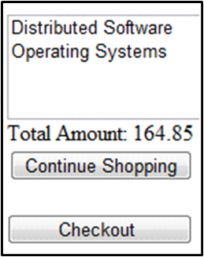
MyCart.aspx.cs
public partial class MyCart : System.Web.UI.Page {
protected void Page_Load(object sender, EventArgs e) {
Double totalAmount = 0;
for (Int16 i = 1; i <= Session.Count; i++) {
string indexKey = "sBook" + i;
Book aBook = (Book)Session[indexKey];
if (aBook._InCart) {
ListBoxCart.Items.Add(aBook._Title);
totalAmount = totalAmount + Convert.ToDouble(aBook._Price);
} }
lblTotalAmt.Text = "Total Amount: "+Convert.ToString(totalAmount);
}
protected void btnToCatalog_Click(object sender, EventArgs e) {
Response.Redirect("Default.aspx"); // continue shopping
}
protected void btnToCheckout_Click(object sender, EventArgs e) {
Response.Redirect(“Checkout.aspx");
} }
Checkout page not shown in this example

Slide 15
Cookie Support to Session State
HTTP is stateless. Each visit is considered to be from a new user;
The browser needs to explicitly carry the session ID (of 120 bits) when it revisits a session and its session variable;
Use a cookie to store the session id
Put the session id in URL as a part of the address
<%@ Page Language = C# %>
<html>
…
sum = sum + [input]
…
</html>
<html>
…
sum = sum + [input]
…
</html>
ASPX forms
ASPX.cs

Slide 16
Storing and Sending Session ID
Client
Browser
Server Side
A unique Hash ID number x
Session
x
Cookie
x
Use a cookie to store the session ID
ID is wrapped in HTTP package
ASPX Application
x
Client Browser
A unique Hash ID number x
x
Session
x
x
ID is stored in browser in a hidden field
Put the session ID is wrapped in URL as a part of the address
ASPX Application

Slide 17
When Shopping and Added Items in Cart
If you do not enable Cookies, you can go back and forth between different pages, you can still see your items in the shopping cart;
If you close your session (browser), your items in the cart disappear
If you enabled cookies, your items in cart will stay even if you have closed the browser;
If you use a different browser, the items will not be visible.

Slide 18
HttpSessionState Class: Public Properties
Contents Gets a reference to the current session-state object.
Count Gets the number of items in the session-state collection.
IsCookieless Gets a value indicating whether the session ID is embedded in the URL or stored in an HTTP cookie.
Mode Gets the current session-state mode.
IsNewSession Gets a value indicating whether the session was created with the current request.
IsReadOnly Gets a value indicating whether the session is read-only.
IsSynchronized Gets a value indicating whether access to the collection of session-state values is synchronized (thread safe).
Keys Gets a collection of the keys of all values stored in the session.
SessionID Gets the unique session ID used to identify the session.
StaticObjects Gets a collection of objects declared by <object Runat="Server" Scope="Session"/> tags within the ASP.NET application file global.asax.
SyncRoot Gets an object that can be used to synchronize access to the collection of session-state values.
Timeout Gets and sets the time-out period (in minutes) allowed between requests before the session-state provider terminates the session. You can set the minutes in web.config file

Slide 19
Session State Setting Using Web.config
UseCookies
UseUri
UseDeviceProfile
AutoDetect
<system.web>
<sessionState
cookieless = “HttpCookieMode values”
timeout = “int, number of minutes”
… >
</sessionState>
</system.web>

Slide 20
HttpCookieMode Values
UseCookies: Always assume that cookies are supported by browser and are enabled.
Session will not work if cookies are not enabled
UseUri: There is a potential problem:
If an absolute path is used in the program, storing session id in browser and use URL will cause an page error.
Session variables discarded after the session is terminated.
UseDeviceProfile: It checks if the browser supports cookies. If it does, set mode to UseCookies; Otherwise, set mode to UseUri.
AutoDetect: It checks if the browser supports cookies and tests if the cookie is enabled, by creating a cookie, saving it, and retrieving it. It is slow as it needs to go back and forth several times between the server and client. Otherwise, set mode to UseUri (mostly in mobile devices).

Slide 21
HttpSessionState Class: Public Methods
Abandon Cancels the current session.
Add Adds a new item to session state, or use Session[“key”] = x;
Clear Clears all values from session state.
CopyTo Copies the collection of session-state values to a one-dimensional array, starting at the specified index in the array.
Equals (inherited from Object) Overloaded. Determines whether two Object instances are equal.
GetEnumerator Gets an enumerator of all session state-values in the current session.
GetType (inherited from Object) Gets the Type of the current instance.
Remove Deletes an item from the session-state collection.
RemoveAll Clears all session-state values.
RemoveAt Deletes an item at a specified index from the session-state collection.
ToString (inherited from Object) Returns a String that represents the current Object.

Slide 22
Using Add and Remove Methods
string itemName = Server.HtmlEncode(TextBox1.Text);
string itemValue = Server.HtmlEncode(TextBox2.Text);
Session.Add(itemName, itemValue);
// Save as Session[itemNae] = itemValue;
RedundantItem itemToRemove = e.Item;
string sessionItemToRemove = ((Label)itemToRemove.FindControl("Label1")).Text;
Session.Remove(sessionItemToRemove);

Slide 23
From Session State to Application State
Session[“index”] allows you to store an object into server memory, and all pages in the session can access the session variable. But data will disappear after closing the browser
Application[“index”] allows you to store an object into server memory. All sessions and all pages in each session can access the application variable;
You can define, for example, Application[“SuperCounter”], similar to the Global.asax file and access the variable in each session;
The challenges remain here: write-write conflict and lock performance, if the application is frequently accessed.

Slide 24
View State
Cross Page Posting
Cookies
Session State and Application State
Server-Side File System
Caching
Database (in next course)

Slide 25
Save Data Permanently into Server Disk
All techniques discussed so far are not permanent. Data can disappear for different reasons.
Session state data disappears after the session is closed.
Application state data (e.g., the global counter) will also disappear if the application is closed. When?
Save into a text file;
Save into a binary file;
Save into an XML file using the XML Writer;
Save into database;
Stream read a string;
Read a variable;
XMLDocument class;
Read from database;
Text chapter 10

Slide 26
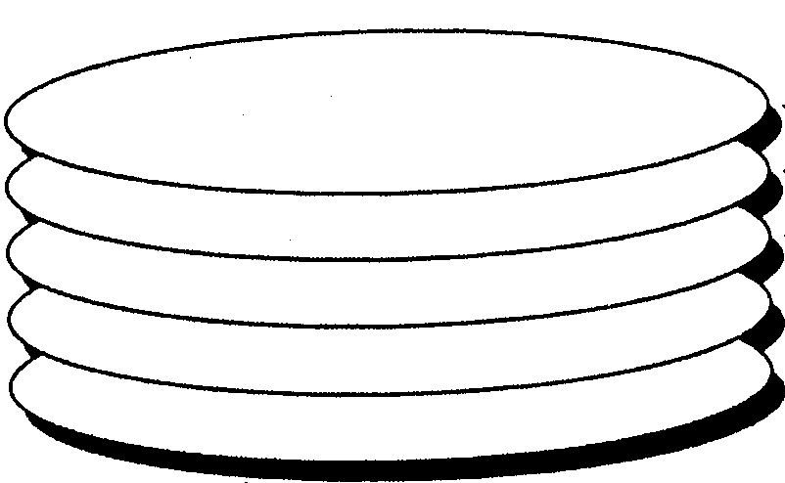
File System Read (and Write) XML Files
OS operations, not a part of ASP .Net
Declare a reference FS of a FileStream type;
Open a file for read or write: It creates a buffer that can hold a block of bytes;
Copy the first block of a file into the buffer;
Create an XML reader or writer that uses the reference to read/write data in the buffer;
When the reference moves down to the end of the buffer, the next block is fetched.
Close the file
memory
File on disk, also called a stream
FS: a reference to the file
A block
Copy a block into the buffer
XML reader or writer
StreamBuffer

Slide 27
A Scenario of XML Data Exchange between ASP application and File System
FileStream
Class
Standard
File
Operations
FileStream
Class
TextBox
input
GridView
TreeView
ListBox
Label
Data elements
XML Writer
Stream Buffer
Stream Buffer
XML Reader
Data elements
Other data sources
Define path and file name
Define path and file name
Other data consumers
Path Class
Path Class
File System

Slide 28
.Net System.IO Namespace and its Classes
Namespace System.IO has a number of classes.
Path class specifies the path and file name to be accessed;
FileStream class creates a buffer and connection to the file system;
string p= @“c:cse445\fileAccess\App_Data\Book.xml”
string fName = Path.GetFileName(p);
Book.xml
string p1 = @“c:cse445\”
string p2 = @“fileAccess\App_Data\Book.xml”
string location= Path.Combine(p1, p2);

Slide 29
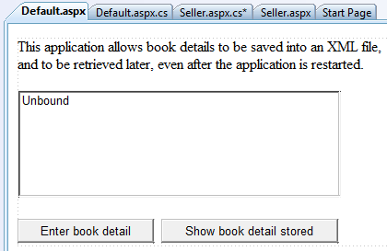
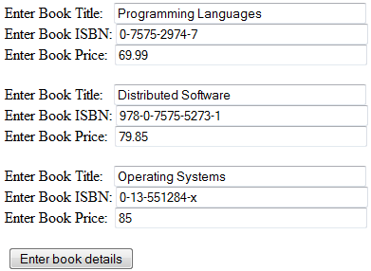
Save Data into an XML-File on Server

Slide 30
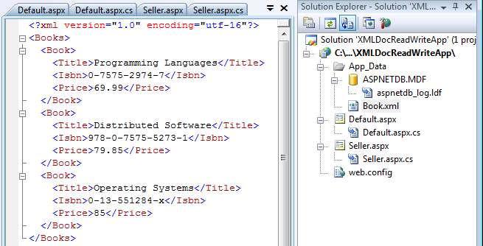
Book.xml Generated through XMLWriter

Slide 31
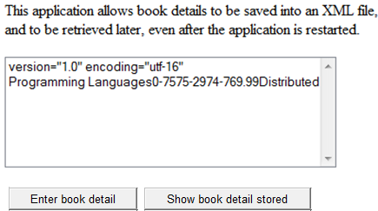
Save Data into XML-File on Server
You can see a better formatted display at this page:
http://venus.eas.asu.edu/WSRepository/XMLDocReadWriteApp/Default.aspx

Slide 32
Code Behind the Default Page
public partial class _Default : System.Web.UI.Page {
protected void btnSeller_Click(object sender, EventArgs e) {
Response.Redirect("seller.aspx");
}
protected void btnShowBook_Click(object sender, EventArgs e) {
FileStream fS = null;
string fLocation = Path.Combine(Request.PhysicalApplicationPath, @"App_Data\Book.xml");
try {
if (File.Exists(fLocation)) {
FileStream fS= new FileStream(fLocation, FileMode.Open, FileAccess.Read);
XmlDocument xd = new XmlDocument();
xd.Load(fS);
fS.Close();
Find path to the current location
Open for read only
Check if the file exists
Load the XML file into memory
Close the file immediately after loading the entire tree.

Slide 33
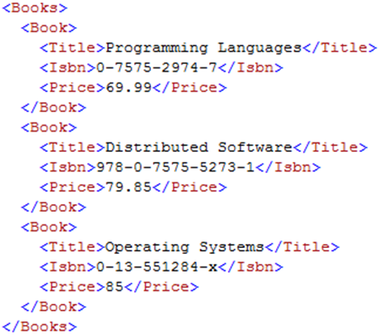
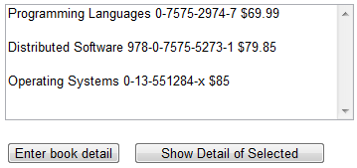
Code Behind the Default (Reader) Page
XmlNode node = xd;
XmlNodeList children = node.ChildNodes;
foreach (XmlNode child in children)
{
ListBox1.Items.Add(child.InnerText);
}
}
finally {
fS.Close();
}
}
}
In case the session crashes
This part of the code needs to be refined, using what you have done in assignment 4 XML processing.

Slide 34
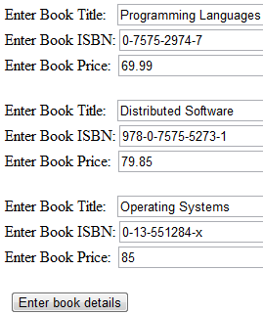
Code Behind the Data Enter (Writer) Page
public partial class Seller : System.Web.UI.Page {
protected void Page_Load(object sender, EventArgs e) {
}
protected void btnEnterBook_Click(object sender, EventArgs e) {
string title1 = txtTitle1.Text;
string isbn1 = txtIsbn1.Text;
string sPrice1 = txtPrice1.Text;
string title2 = txtTitle2.Text;
string isbn2 = txtIsbn2.Text;
string sPrice2 = txtPrice2.Text;
string title3 = txtTitle3.Text;
string isbn3 = txtIsbn3.Text;
string sPrice3 = txtPrice3.Text;
Taking data from text boxes
Taking data from text boxes

Slide 35
Code Behind the Data Enter (Writer) Page
string fLocation = Path.Combine(Request.PhysicalApplicationPath, @"App_Data\Book.xml");
if (File.Exists(fLocation)) {
File.Delete(fLocation);
}
FileStream fS = null;
try {
fS = new FileStream(fLocation, FileMode.CreateNew);
XmlTextWriter writer = new XmlTextWriter(fS, System.Text.Encoding.Unicode);
writer.Formatting = Formatting.Indented;
writer.WriteStartDocument();
writer.WriteStartElement("Books");
writer.WriteStartElement("Book");
writer.WriteElementString("Title", title1);
writer.WriteElementString("Isbn", isbn1);
writer.WriteElementString("Price", sPrice1);
writer.WriteEndElement();
// or: HttpRuntime.AppDomainAppPath
In this example, delete the file if it exists
In this example, delete the file if it exists, and create a new file
Other modes include OpenOrCreate, Append, …
See chapter 4 slides on XMLWriter

Slide 36
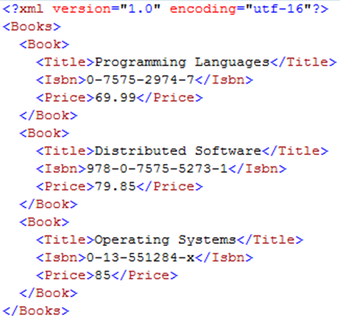
Code Behind the Data Enter (Writer) Page
XMLWriter continues to wrote
writer.WriteStartElement("Book");
writer.WriteElementString("Title", title2);
writer.WriteElementString("Isbn", isbn2);
writer.WriteElementString("Price", sPrice2);
writer.WriteEndElement();
writer.WriteStartElement("Book");
writer.WriteElementString("Title", title3);
writer.WriteElementString("Isbn", isbn3);
writer.WriteElementString("Price", sPrice3);
writer.WriteEndElement();
writer.WriteEndElement();
writer.WriteEndDocument();
writer.Close();
fS.Close();
}
It is necessary to close the XMLWriter and to close the file stream connection. You cannot open the file if any one is open.
It is necessary to close the XMLWriter and to close the file stream connection. You cannot open the file if any one is open.

Slide 37
Code Behind the Data Enter (Writer) Page
In case the session crashes
finally {
fS.Close();
}
Response.Redirect("Default.aspx");
}
protected void txtIsbn_TextChanged(object sender, EventArgs e)
{
// can write an event handler to do something as user types
}
}

Slide 38
Discussions: Book.xml (Catalog) File
Book.xml is the catalog and is accessible by the public;
It can be read by many shoppers simultaneously
FileStream fS= new FileStream(fLocation, FileMode.Open, FileAccess.Read);
Multiple sessions can open and read at the same time.
Other modes are FileAccess.Write and FileAccess.ReadWrite
Many sellers can try to write it simultaneously
fS = new FileStream(fLocation, FileMode.CreateNew); or
FileStream fS= new FileStream(fLocation, FileMode.Open, FileAccess.Write);
As this example does not have screening function, it could get overflow.
Is a deadlock possible on Book.xml ?

Slide 39
More Realistic Data Structures
public class StoreItem {
public string _ItemName;
public string _ItemNo;
public double _UnitPrice;
public int _Stock; // Number of items available in store
public int _InCart; // Number of items in customer carts
}
public class CartItem{
public string _ItemName;
public string _ItemNo;
public double _UnitPrice;
public int _Amount; // Number of items in shopping cart
public bool _InStock
}
Use these two numbers to predict how many items should be ordered.
Order too many: load cost and storage cost
Order too few: lose business opportunity

Slide 40
Managing Your Data Files
StoreItems.xml
When a client adds an item in cart:
Open InCartItem[i].xml;
_Amount++
Open StoreItems.xml
_InCart++;
Close InCartItem[i].xml
Close StoreItems.xml
InCartItems[i].xml
int _Stock
int _InCart
int _Amount;
bool _InStock
The store orders 10 more items:
Open StoreItems.xml
_Stock = _Stock+10;
Open InCartItem[i].xml;
_InStore = true
Close StoreItems.xml
Close InCartItem[i].xml

Slide 41
Dead Lock
Dead Lock Prevention
When a client adds an item in cart:
Open InCartItem[i].xml;
_Amount++
Open StoreItems.xml
_InCart++;
Close InCartItem[i].xml
Close StoreItems.xml
When a client adds an item in cart:
Open InCartItem[i].xml;
_Amount++
Close InCartItem[i].xml
Open StoreItems.xml
_InCart++;
Close StoreItems.xml
The store orders 10 items:
Open StoreItems.xml
_Stock = _Stock+10;
Open InCartItem[i].xml;
_InStore = true
Close StoreItems.xml
Close InCartItem[i].xml
The store orders 10 items:
Open StoreItems.xml
_Stock = _Stock+10;
Close StoreItems.xml
Open InCartItem[i].xml;
_InStore = true
Close InCartItem[i].xml

